Slide 1
Nigerian Regional Peace Index
Forecasting Insurgency within Nigeria
By:David Hatem

Slide 2
Background
As a newly emergent democracy, Nigeria has the natural resources and workforce to emerge as one of the larger economies on a global scale.
As is, Nigeria is Africa’s largest economy, with annual GDP topping one trillion dollars.
Although many obstacles stand in the way of Nigeria diversifying its economy, national security is a glaring deficiency that must be addressed.
The question becomes, how does the country address attacks form paramilitary groups so that it may continue to grow and prosper?

Slide 3
The Index
The idea is to use the same forecasting techniques used to predict financial product performance to predict instances of insurgent violence, particularly on behalf of Boko Haram.
Using publicly available data , I sought to map out patterns that could be used to predict areas and months where violence was most likely to occur.
The resulting tool is replicable, able to easily integrate new data, and has already yielded a statistically significant, accurate projection.
The index has been applied to Borno State in this instance, as there tends to be significant Boko Haram activity there.

Slide 4
Nuts and Bolts
Using publicly available data from the Partners for Peace Map (http://www.tgpcloud.org/p4p/index.php?m=p4p), I extracted the dates and frequencies of all Boko Haram attacks in Borno State for 2011-2016.
With these tables read into R, I utilized the “forecast” package commonly used to predict financial product performance. This provided me with an Auto-Regressive Integrated Moving Average (ARIMA) model
ARIMA modeling accounts for past data influencing future data, and also teases out how far off the data is from having a mean of 0 and constant variance.

Slide 5
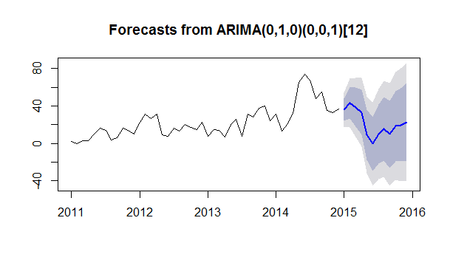
The Results
Above, Boko Haram incidents for 2015 are shown. The dark blue line representing the projection, the dark blue shading represents the 95% confidence interval, and the light blue shading represents the 80% confidence interval.

Slide 6
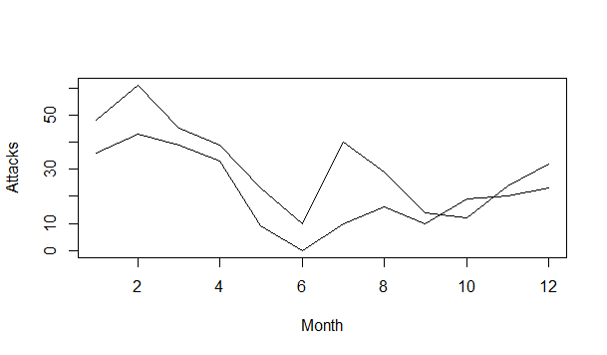
Results cont.
Above, we see the predicted 2015 attacks versus the actual occurrences. The top line represents the actual attack frequency, and the bottom line represents the predicted attack frequency. As you can see, the model can predict the general ebb and flow of attack frequency on only 4 years of previous data.

Slide 7
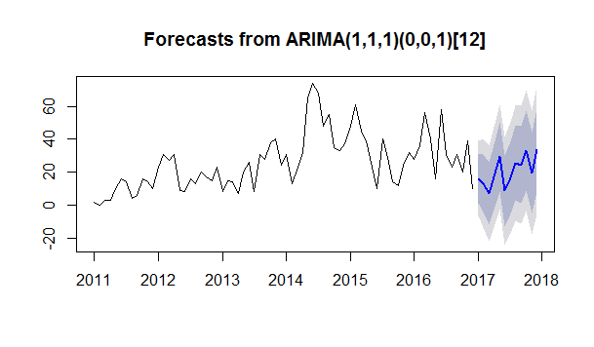
Results cont.
Above, we see 2017’s projected attack frequency based on the data from years 2011-2016. Again, the projection is represented by the dark blue line, the 95% confidence interval is represented by the dark blue shading, and the 80% confidence interval is represented by the light blue shading.

Slide 8
Policy Suggestions
With November, December, and January of each calendar year tending to be quieter than other times of the year, these would be the safest months to commission short term infrastructure projects, such as road repair or electrical grid maintenance. This recommendation would also apply to short/intermediate term relief efforts in Borno.
Additionally, this time window coincides with Borno State’s dry season, which lends itself well to infrastructure projects.
Bottom Line: Plan for infrastructure development and relief activity to occur in November, December, or January.

Slide 9
Policy Suggestions Cont.
With the exception of June 2014, there seems to be a persistent drop in violence during the month of June. It appears that the month of June would be best to host community events, national/international conferences, and other short term endeavors.
Future tourist events would be well timed in June. There’s consistent summer weather and June coincides with the end of what is usually a two-month span of rainy weather in April and May.
Bottom Line: Tourist events, conferences, and other happenings taking less than one month should be planned in June.

Slide 10
Policy Suggestions Cont.
Stagger the presence of security forces throughout the state and country according to attack frequency projections.
It may prove more efficient to use security forces in a relief capacity in June following the rainy season. This would allow humanitarian relief to take place, while still maintaining adequate forces to defend against Boko Haram.
Bottom Line: Disperse national security forces in proportion to the threat that Boko Haram poses in a given time of year.
This is first and foremost. Investment requiring a domestic workforce and pre-existing infrastructure would be difficult or impossible without relief from the destruction of the rainy season.

Slide 11
Future Research
The forecasting process could easily be staggered by a specific LGA (local government area) within Borno to get a more detailed picture of where and when Boko Haram is attacking.
Previous years’ data can be added to the forecasting process to draw from a larger sample size, increasing the accuracy of future projections.
As with Borno, other states within Nigeria have similar data recorded. This forecasting process could be applied to any of them as well.
These findings constitute only the beginning of the research that can be done. I fully intend to pursue further research on the subject to create more meaningful, precise forecasts.

Slide 12
In Conclusion
I would like to thank you for your time in reviewing these findings. It is my hope that as the field of Data Science burgeons, it will be seen as a medium to help solve humanity’s most pressing problems. Data Science as a field must be utilized as an environment for positive social change.
If you would like to support Partners for Peace in the Niger Delta, please visit them at http://www.p4p-nigerdelta.org/

